Slide 1

Group-5
LIBRARY MANAGEMENT
Team Members:-
YANRONG HUANG
AKASH SUMARIA
VENKATA SAI KRISHNA PARUCHURI
SHEMAL SHAH
SIWEI ZHOU

Slide 2
SUMMARY
High Light
The Library Management system (LMS) is designed to address the problems as follow:
• Any library patron should be able to search for books by title, author, subject category, and publication date.
• The system should be able to keep track of information such as who took which book.
• The number of books a member can check out should be limited to three
• Members should be allowed to make reservations for books and rooms
Email confirmation:
Using trigger to send email to user.
GUI:
Implement database into use.

Slide 3
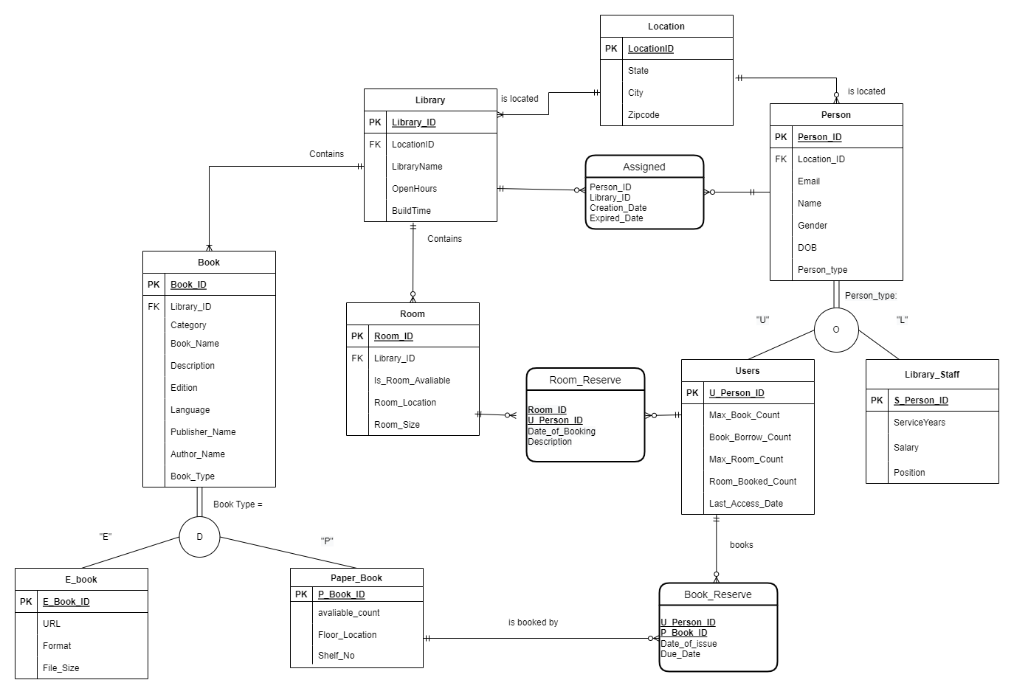
ER-Diagram

Slide 4
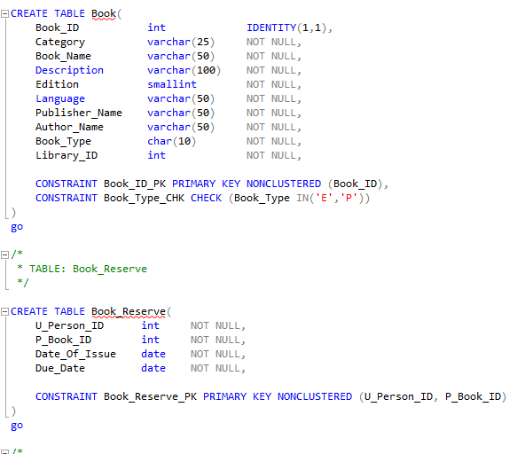
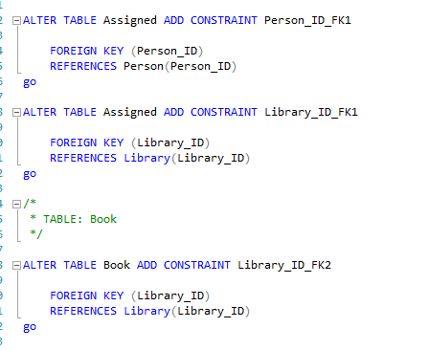
DDL Statements

Slide 5
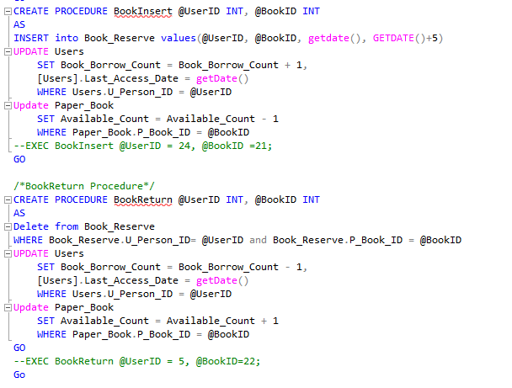
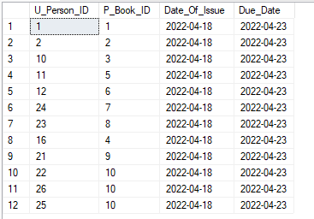
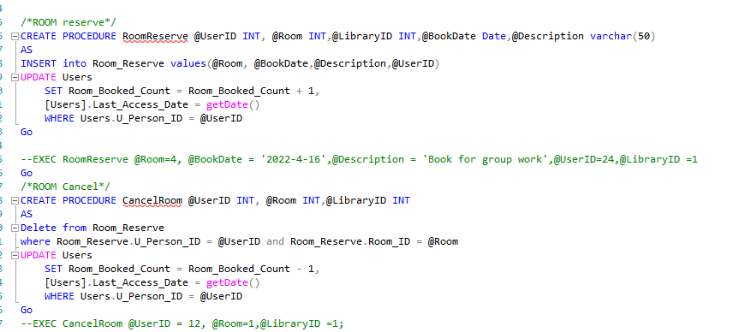
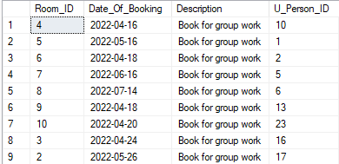
Procedures

Slide 6
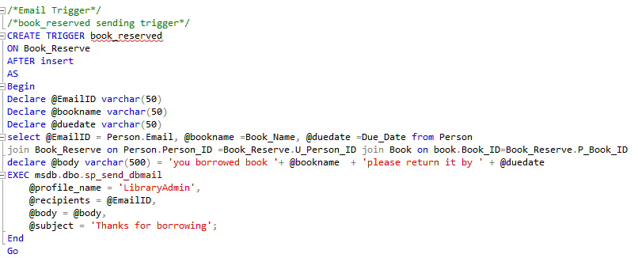
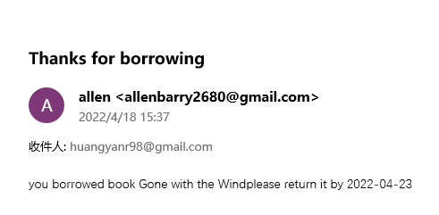
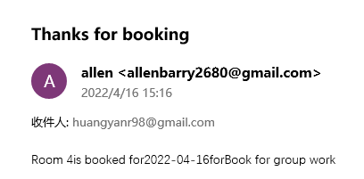
Triggers

Slide 7
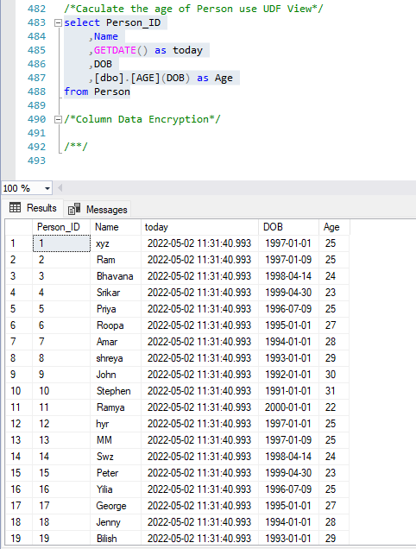
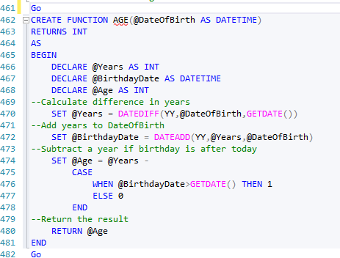
Functions

Slide 8
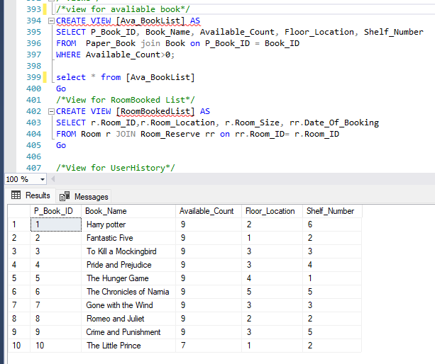
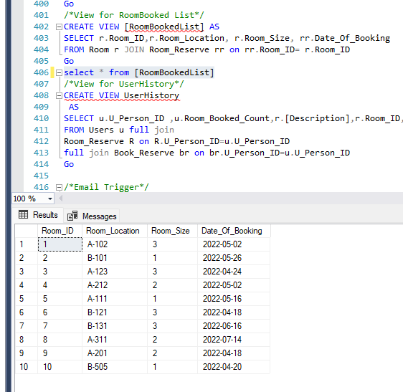
Views

Slide 9
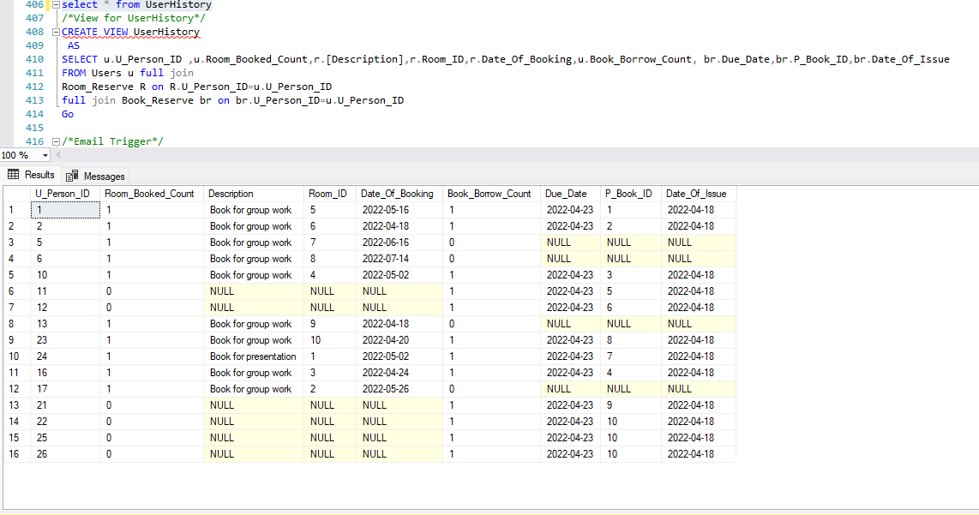
Views

Slide 10
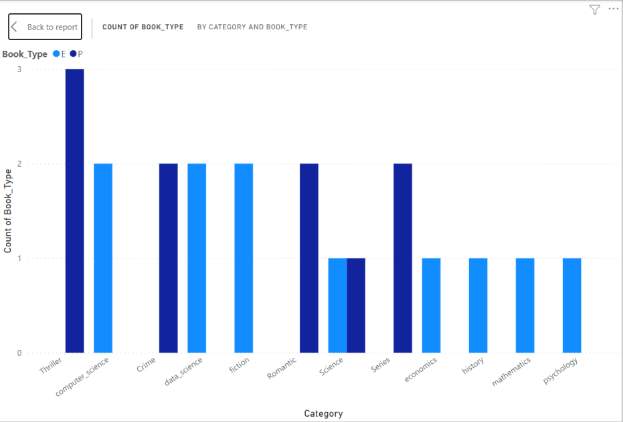
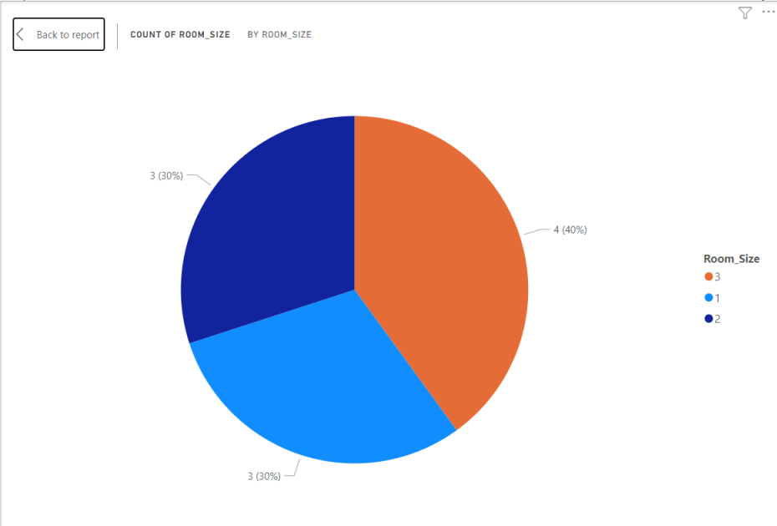
Dashboards / Reports
Shows Number of different catalog of paper books and e-books in the library.
Room Size pie chart

Slide 11
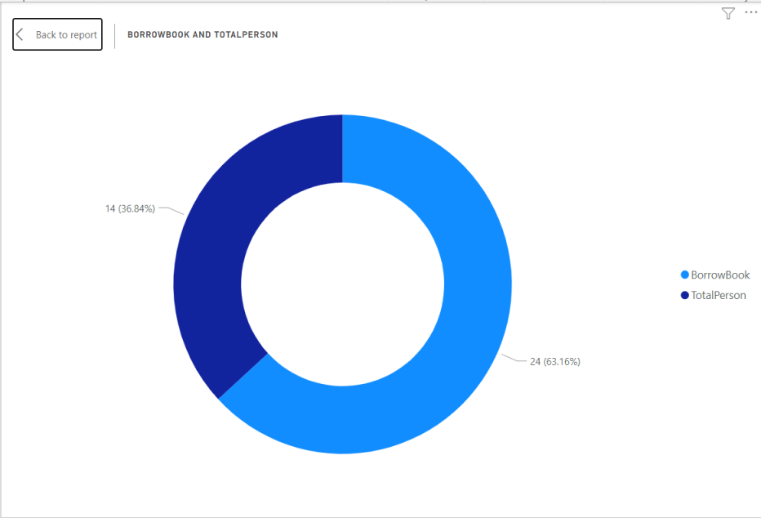
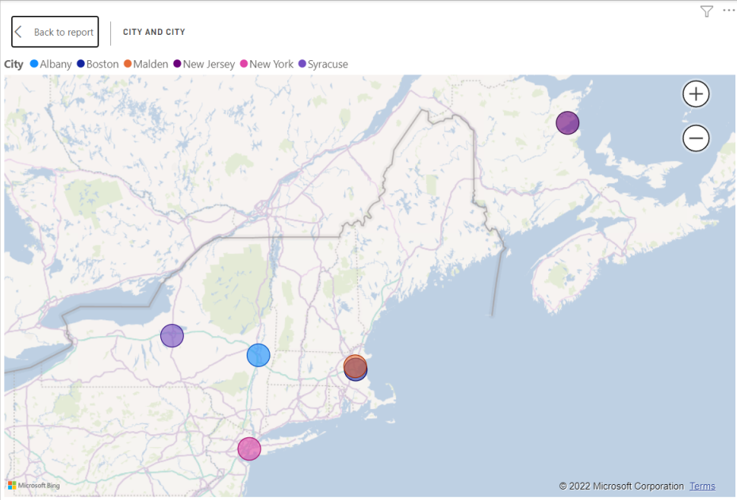
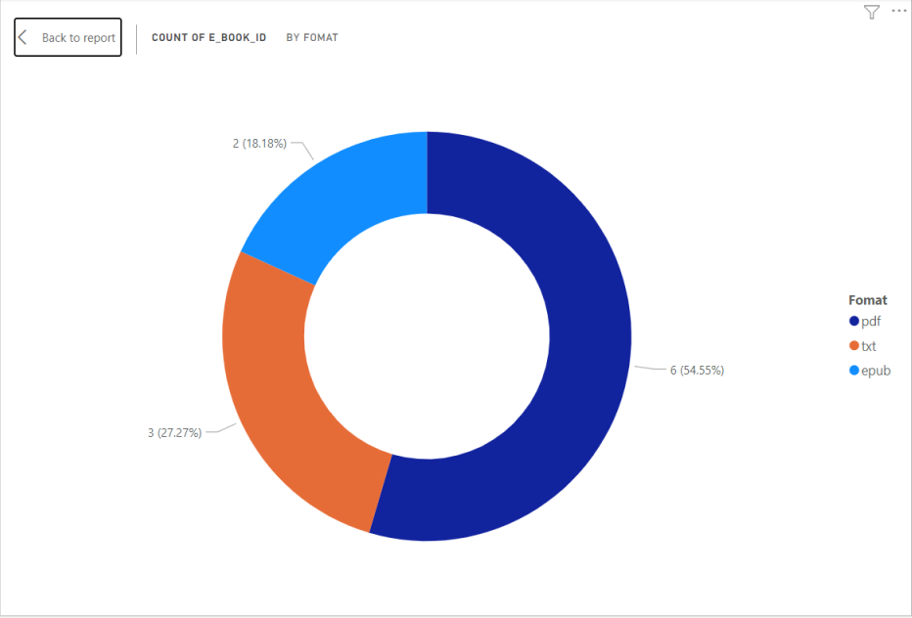
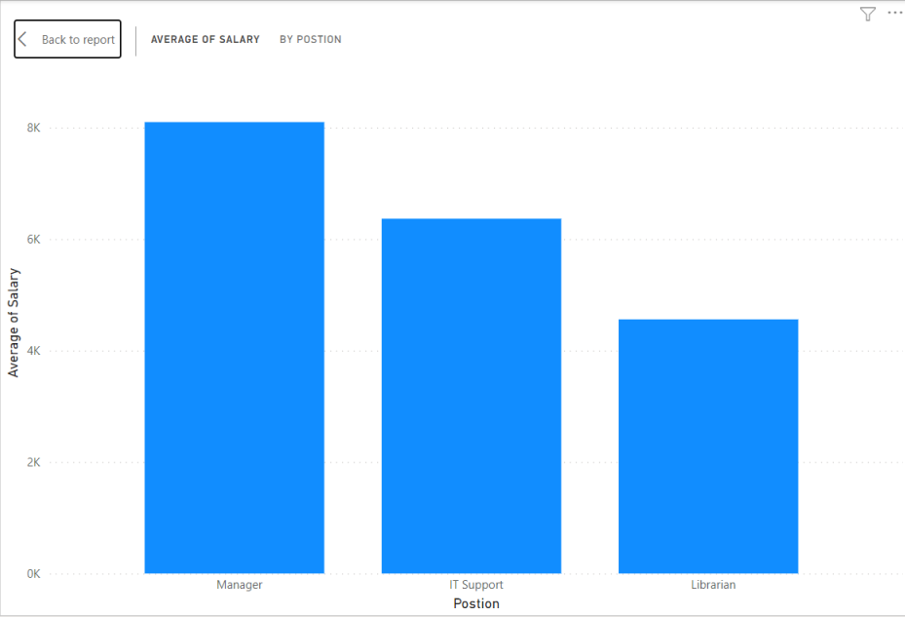

Slide 12
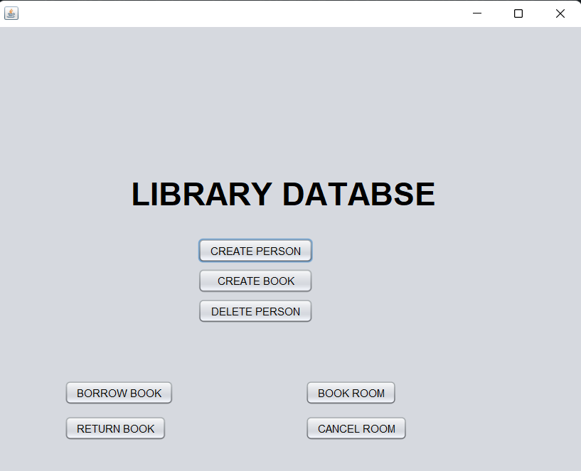
Graphic User Interface (GUI)

Slide 13
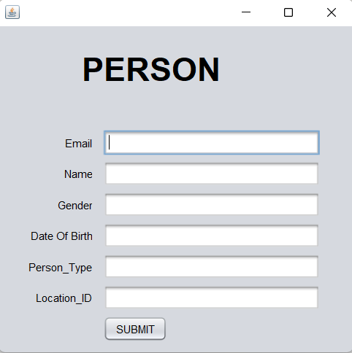
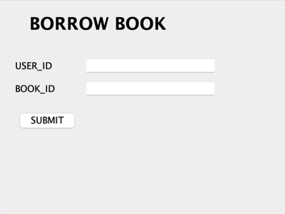
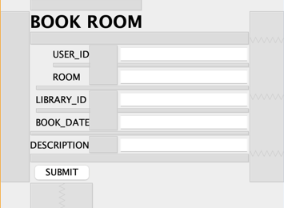
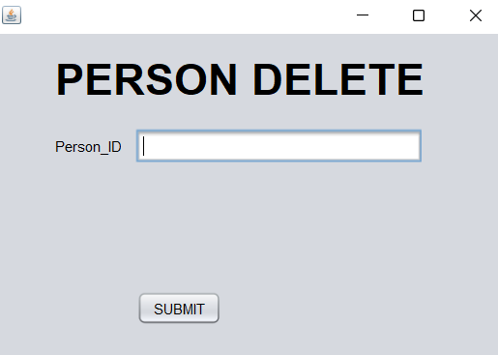
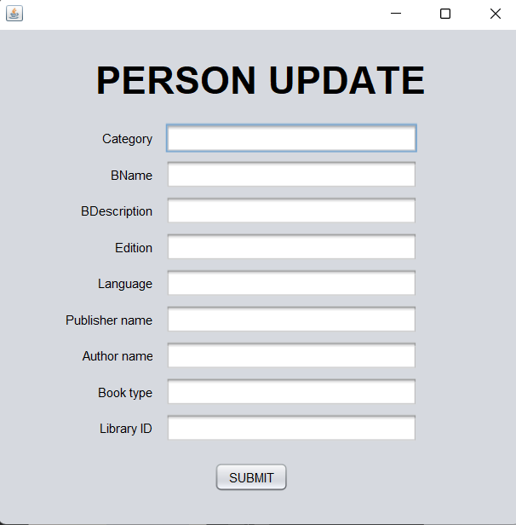
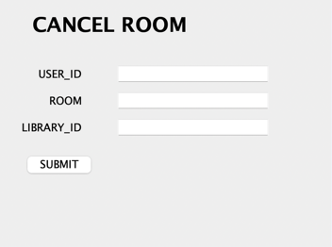
GUI of Project

Slide 14

Thank you!

